Slide 1
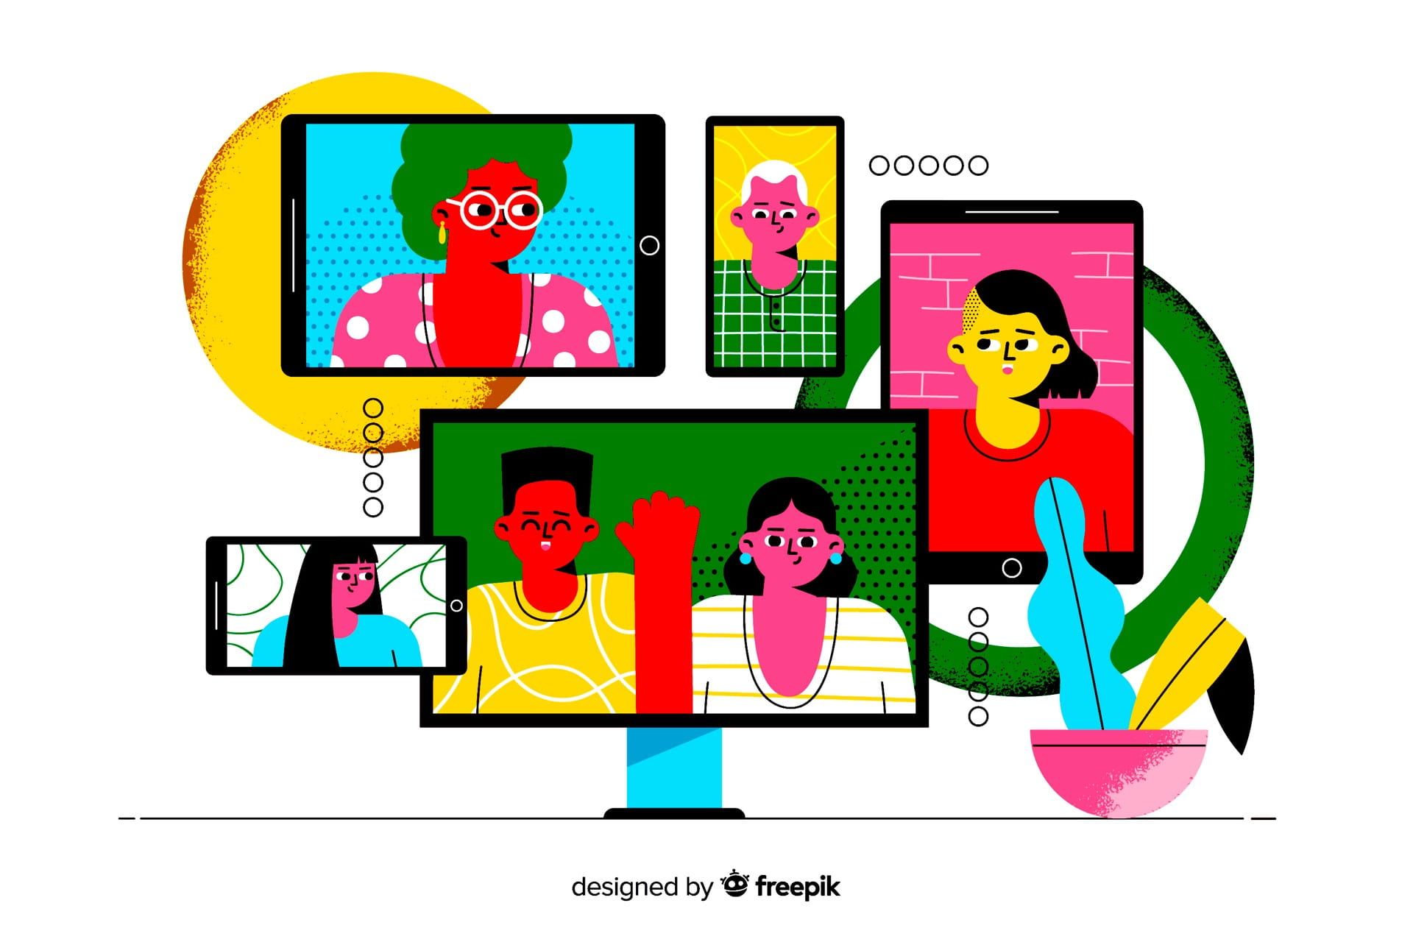

Etika dalam Komunikasi Virtual
This Photo by Unknown Author is licensed under CC BY-NC-ND

Slide 2


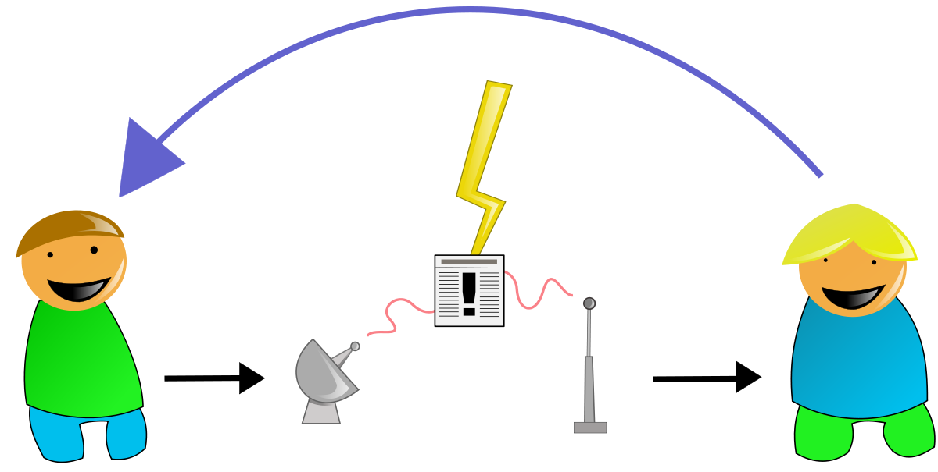
APA SIH KOMUNIKASI?
This Photo by Unknown Author is licensed under CC BY-SA-NC
This Photo by Unknown Author is licensed under CC BY-SA

Slide 3
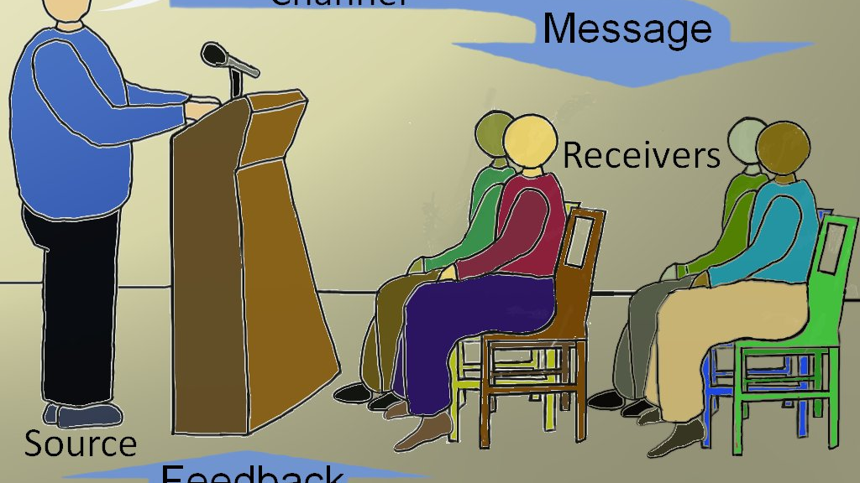
BERAPA KALI ANDA BERINTERKSI DENGAN ORANG ?
BERAPA KALI ANDA MEMBERIKAN SENYUMAN DENGAN ORANG?
BERAPA KALI ANDA BERSALAMAN DENGAN ORANG?
This Photo by Unknown Author is licensed under CC BY-SA

Slide 4

This Photo by Unknown Author is licensed under CC BY
BAGAIMANA INTERAKSI PENGELOLA DENGAN LEMBAGA JASA INFORMASI DISEKITAR ANDA DENGAN PARA PENGGGUNA?

Slide 5
Seberapa jauh tahu Komunikasi ?
communication
skill
art
science

Slide 6
Komunikasi itu ...
Proses
Model
Etika

Slide 7

Unsur komunikasi
Model “S-M-C-R” (Berlo,1960):
Sumber/pengirim pesan (source)
Pesan (message)
Media/Saluran pesan (channel)
Penerima pesan (receiver)
Model ini merupakan konsep komunikasi yang paling sederhana
This Photo by Unknown Author is licensed under CC BY-SA-NC

Slide 8

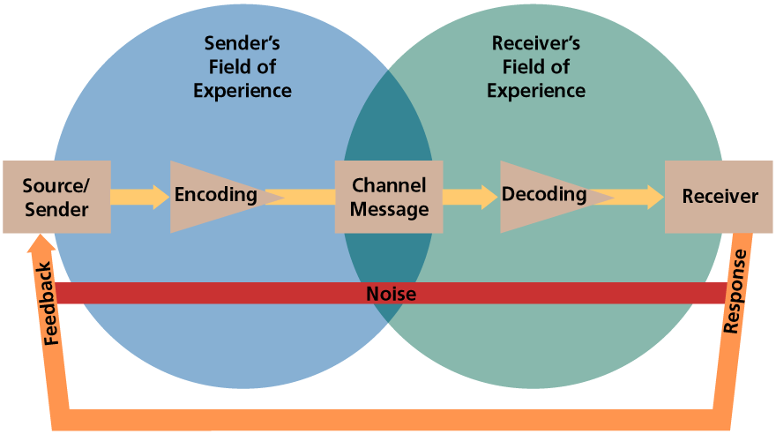
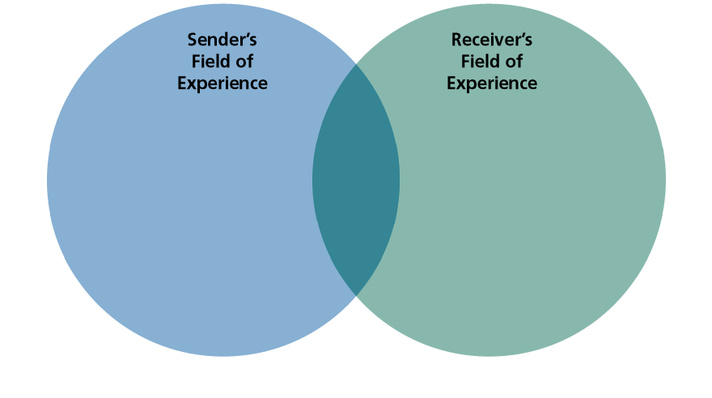
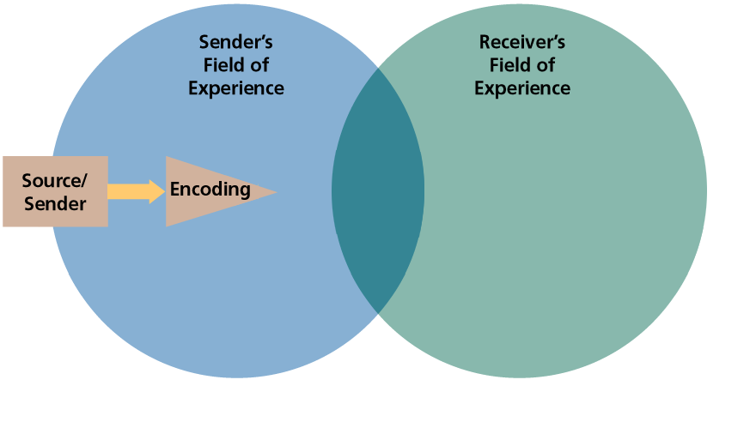
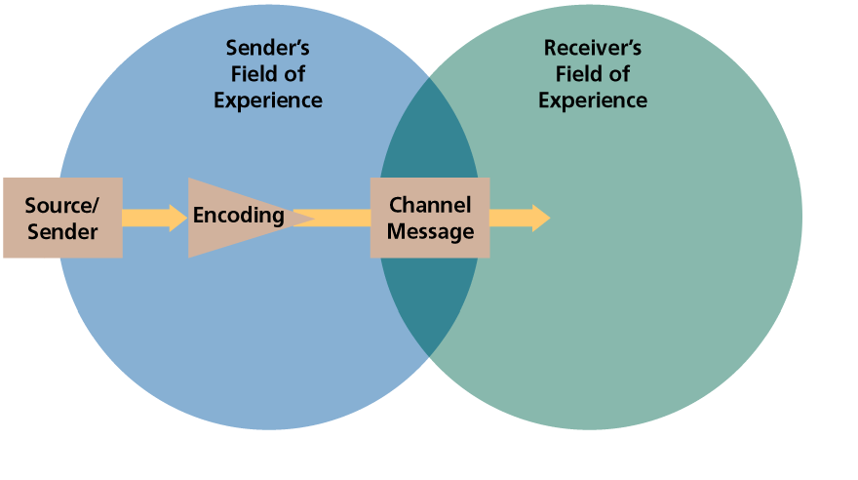
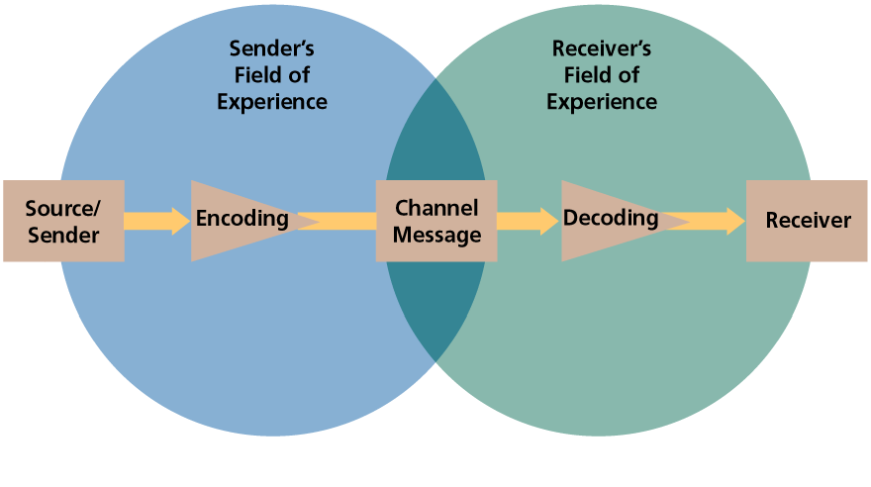
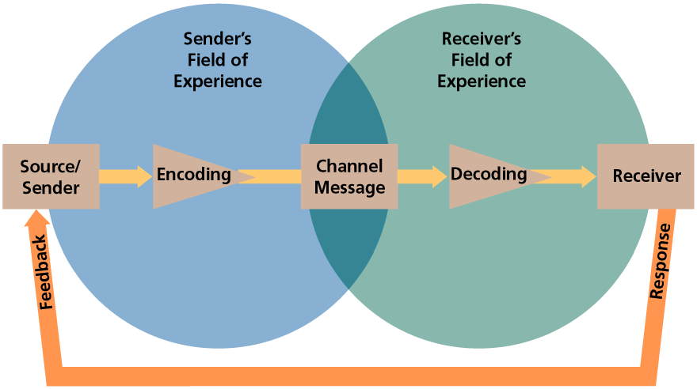
Proses Komunikasi
MODEL
Notes:
Relation to text This slide relates to material on pp.139 and Figure 5-1 of the text.
Summary Overview This slide provides an overview of the basic elements of the communications process which includes:
Source/Sender – the person or organization that has information to share
Receiver – person(s) with whom the sender is sharing thoughts
Message – the information the source hopes to convey
Channel – method by which the communication travels from source to receiver
Encoding – putting thoughts, ideas, or information into symbolic form
Decoding – transforming the senders message back into thought
Response – receiver’s reactions after seeing, hearing, or reading the message
Feedback – part of the receiver’s response that is communicated back to the sender
Noise – unplanned distortion or interference
Use of this slide This slide can be used to introduce the communication process and discuss the basic elements in a communication system. It is important for students to understand each of these elements and the role they play in the communication process.

Slide 9
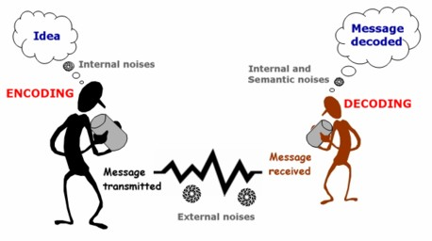
Bagaimana Komunikasi Terjadi ?

Slide 10
KOMUNIKASI
VERBAL
dan
NON VERBAL
This Photo by Unknown Author is licensed under CC BY-NC-ND

Slide 11
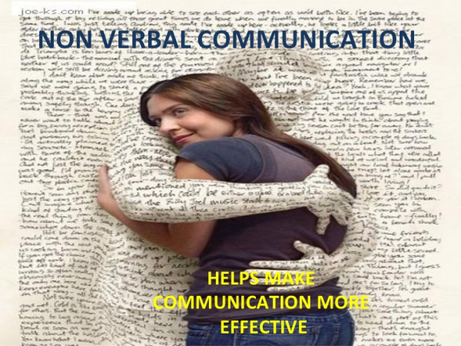
This Photo by Unknown Author is licensed under CC BY-NC-ND

Slide 12
Hambatan dalam berkomunikasi:
Perbedaan bahasa dan persepsi
Gangguan komunikasi (emosional dan fisik)
Overload informasi
Penyaringan yang tidak tepat

Slide 13
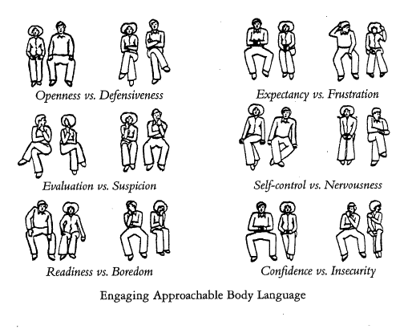
This Photo by Unknown Author is licensed under CC BY-NC

Slide 14
Aktivitas dalam mendengar:
Sensing
(memahami): kemampuan mendengar
Filtering
(menyaring): proses memahami simbol, dipengaruhi oleh pengalaman dan kemampuan berkomunikasi
Remembering
Remembering (mengingat): dipengaruhi oleh intensitas

Slide 15

JENIS KOMUNIKASI
Dilihat dari alat (perangkat) yang digunakan:
Akoptika: jenis komunikasi yang menggunakan akustik (indera telinga) dan sekaligus menggunakan optik (indera mata) contoh: bahasa, bunyi, api, asap, insyarat
grafika: menggunakan alat-alat cetakan sehingga menghasilkan bahan tercetak/tertulis, contoh : surat kabar, buku, majalah, surat.
elektronika: menggunakan alat-alat elektronik atau perangkat telekomunikasi, contoh: TV, telepon, radio.
This Photo by Unknown Author is licensed under CC BY-SA

Slide 16
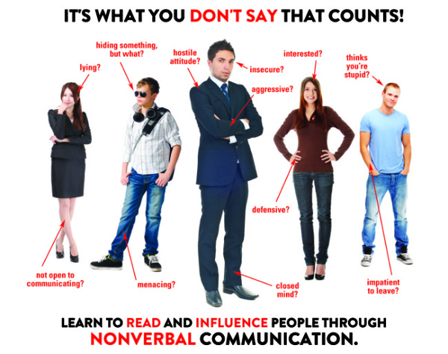
This Photo by Unknown Author is licensed under CC BY-NC-ND

Slide 17
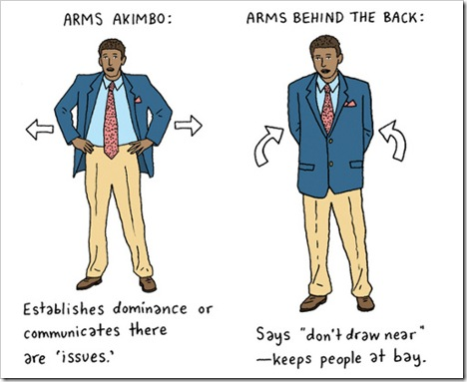
This Photo by Unknown Author is licensed under CC BY-NC

Slide 18

This Photo by Unknown Author is licensed under CC BY-SA-NC

Slide 19
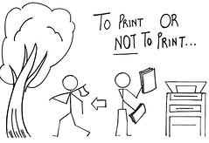
This Photo by Unknown Author is licensed under CC BY-SA-NC

Slide 20
